Slide 1
Capstone Project Python
By: Diana F

Slide 2
Table of Contents
SDLC
Product
Design Algorithm
Q & A
Jira
ROLL YOUR DICE

Slide 3
01
Question 1
Roll the Dice
SDLC
Implementation
The Software Development Lifecycle

Slide 4
The Software Development Cycle
Roll the Dice
Planning
Analysis
Design
Define the purpose of the dice program
Specify the features and functionalities (graphical representation of dice faces)
Break down the requirements
Into smaller tasks
Analyze potential risks and challenges
Design the graphical representation of dice faces.
Decide on the programming constructs and algorithms for random dice rolls
Implementation
Testing & Integration
Maintenance
Write the Python code based on the design
Implement the “roll_dice” function and its components
Test to see if there are any bugs and fix bugs
The code is up to date so minimal updates needed

Slide 5
02
Question 2
Roll the Dice
Design
Algorithm
What does my pseudocode look like?

Slide 6
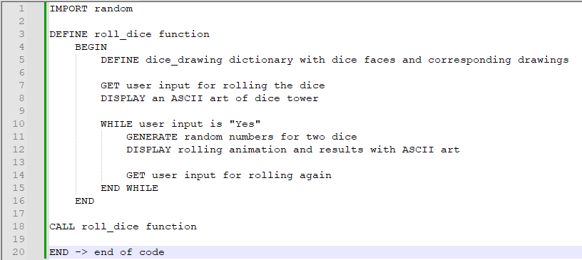
Roll the Dice

Slide 7
03
Question 3
Roll the Dice
Jira
What is Jira?

Slide 8
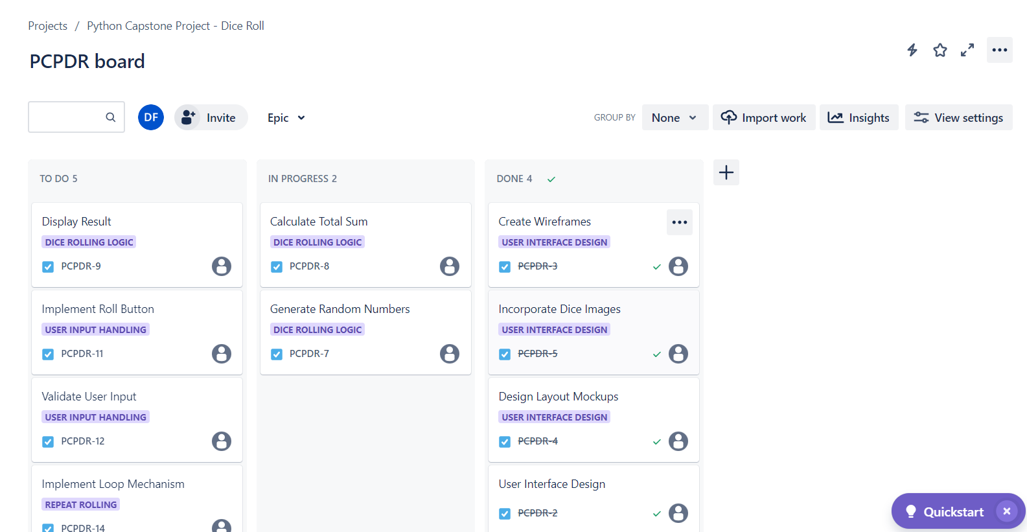
Jira
Roll the Dice
Super Power?
Super Velocity?
Mercury is the smallest planet in the Solar System
Jupiter is the biggest planet in the Solar System

Slide 9
04
Question 4
Roll the Dice
Product
How does your product look like?

Slide 10
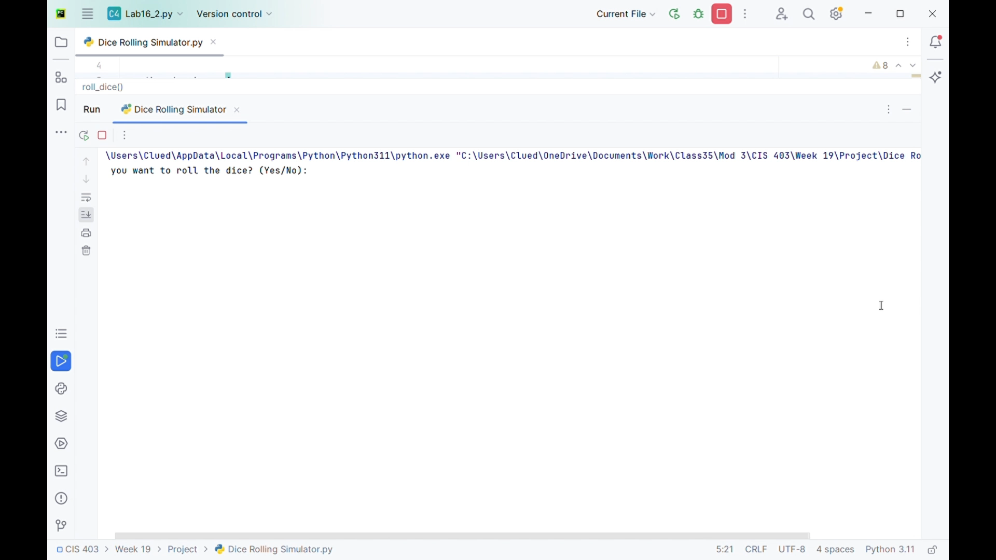
Roll the Dice

Slide 11
Questions
&
Answers
Do You Have Any Questions?

